Slide 1

Autoimmune diseases are devastating
50M
$100B
9%
Annual US expenditure on treatment
Americans affected
Annual CAGR
but care is constrained by inefficient diagnostic evaluations
4.6yr
4.8
Average time to diagnosis
Average physicians seen

Slide 2


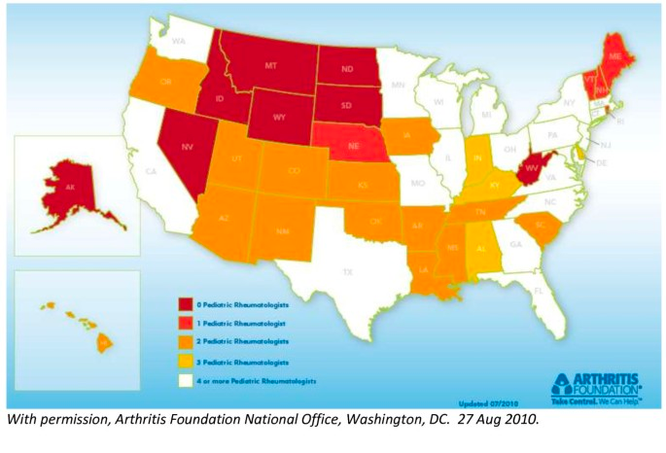
And a rheumatology shortage
200mi
Travel for appointment in rural areas

Slide 3
Clarys
Next-gen digital biomarkers for autoimmune diseases

Slide 4

Clarys lets clinicians make early, objective diagnoses for autoimmune diseases
30s
starting with:
dermatomyositis
scleroderma
lupus
With Clarys biomarkers

Slide 5
Our proprietary AI models analyze image biomarkers
1
2
3
Image uploaded
Clarys analysis
Diagnosis & suggestions
Clinicians submit pictures of skin lesions
Visual & graphic analysis via ML models
Enables early & personalized interventions

Slide 6



The preliminary research is there

Slide 7

Why skin lesions?
20%
Lupus patients have skin lesions as first symptom
80%
Lupus patients present skin lesions
“You can control it before a person ends up with a life-altering disease.”

Slide 8
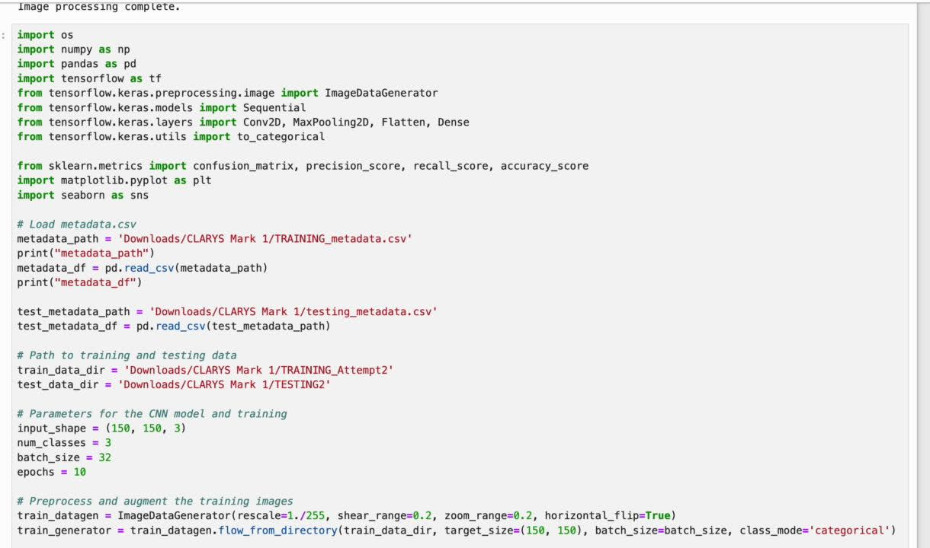
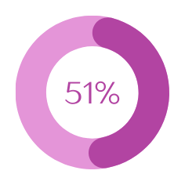
We built the first autoimmune skin lesion image dataset
+600
Images trained on
1.3M
Accuracy
Parameters in our training data

Slide 9

And are going after a massive market
$1.4B
$50K annual fee
revenue opp. for top 3 skin autoimmune diseases
Priced on 15x ROI for clinics*
only need 20 clinics for $1M ARR
*20 new patients/day/clinic x 50 weeks / year x $3k costs/ patient = $3mil
with Clarys, can view 50% more patients = $1.5mil annual savings

Slide 10
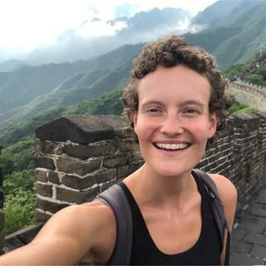

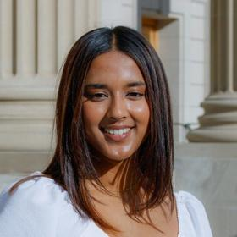
Leveraging our unique expertise in startups & immunology
Grace Gerwe
Archit Kalra
Meghana Chamarty
Immunoengineering @ Yale
President of Yale Entrepreneurial Society for 2.5 years
Investment Partner at Dorm Room Fund
Neuroscience & Physics @ Yale
Yale Undergrad Capital Partners Analyst
Space Force computing lab researcher
CS & Biochem @ Yale
Yale Ventures Associate
Researcher @Yale Clinical Neuroscience Group for Neuroanalytics

Slide 11
We need funding to:
1
Establish partnerships with clinicians
2
Expand our dataset
3
File IP

Slide 12
Clarys
Spotting wellness, preventing crisis.

Slide 13
Appendix

Slide 14





Competition
Clarys
image-based
virtual option
product-market fit

Slide 15
The rheumatology shortage
5600
4700
200mi
Current practicing rheumatologists in US
Rheumatologist shortage by 2030
Travel for appointment in rural areas

Slide 16
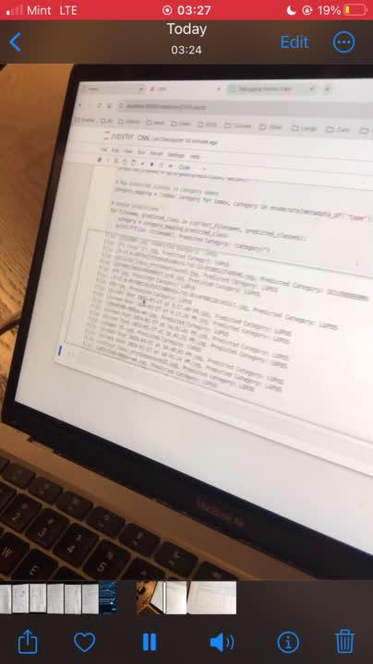
First successful run :)

